Slide 1

Empirical Evaluation of speech emotion recognition
DEEP PATEL
SUHAS DHAR

Slide 2
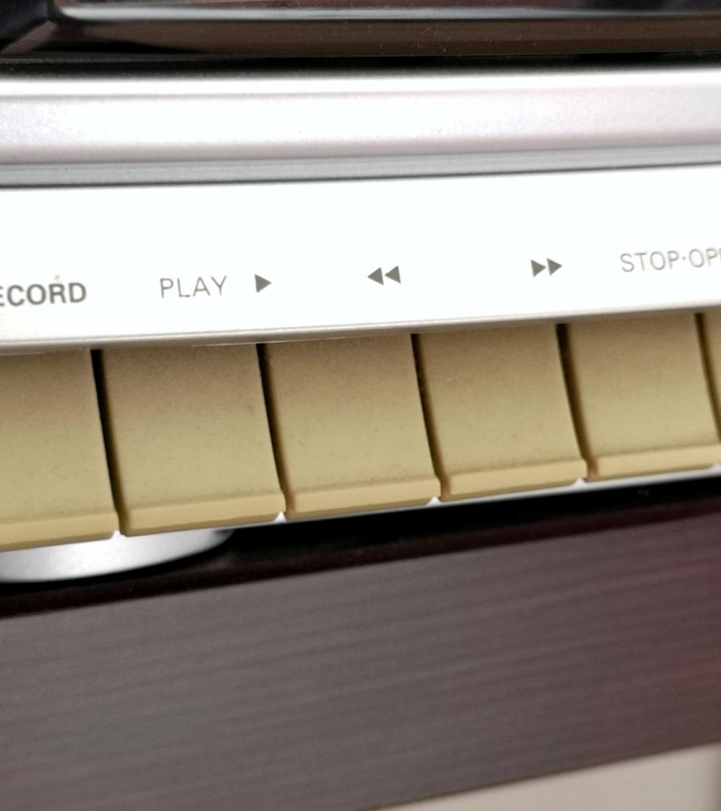
About us
SUHAS DHAR 7007219850
E-Mail : SXD19850@UCMO.EDU
DEEP PATEL 7007344450
E-Mail : DXP44450@UCMO.EDU
A

Slide 3
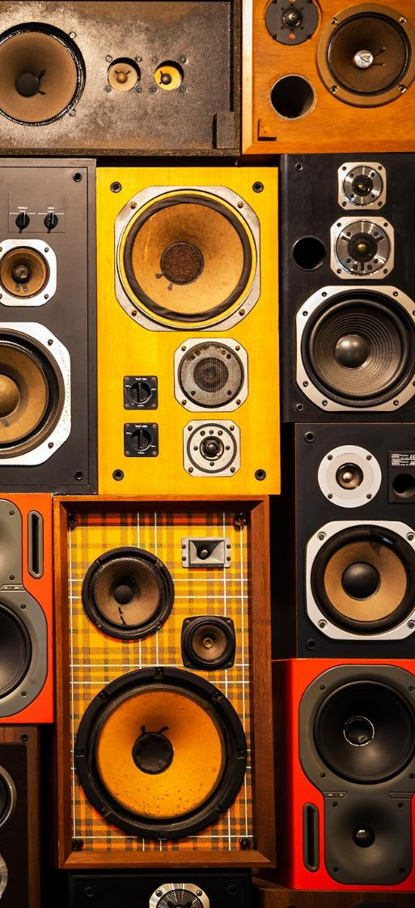
Planned Steps:
1. Data Preprocessing
2. Divide test and train data
3. Normalization of the Data Set.
4. Review the CNN model
5. Build the Convolutional Neural Network
6. Compile the data on the model.
7. Model fitting
8. Confusion matrix generation
?

Slide 4
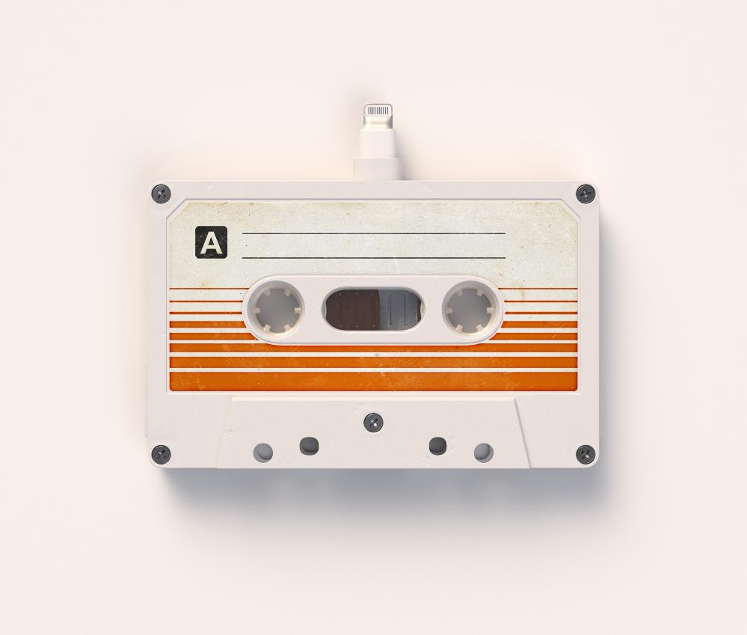
What is speech recognition (SER)?
Speech Emotion Recognition, abbreviated as SER, is the act of attempting to recognize human emotion and affective states from speech.
This is capitalizing on the fact that voice often reflects underlying emotion through tone and pitch.
This is also the phenomenon that animals like dogs and horses employ to be able to understand human emotion.

Slide 5

Why we need SER??
1. Emotion recognition is the part of speech recognition which is gaining more popularity and need for it increases enormously. Although there are methods to recognize emotion using machine learning techniques, this project attempts to use deep learning to recognize the emotions from data.
2. SER(Speech Emotion Recognition) is used in call center for classifying calls according to emotions and can be used as the performance parameter for conversational analysis thus identifying the unsatisfied customer, customer satisfaction and so on.. for helping companies improving their services.
3. It can also be used in-car board system based on information of the mental state of the driver can be provided to the system to initiate his/her safety preventing accidents to happen.

Slide 6

Datasets used in this project
1) Crowd-sourced Emotional Multimodal Actors Dataset (Crema-D)
2) Ryerson Audio-Visual Database of Emotional Speech and Song (Ravdess)
3) Surrey Audio-Visual Expressed Emotion (Savee)
4) Toronto emotional speech set (Tess)

Slide 7
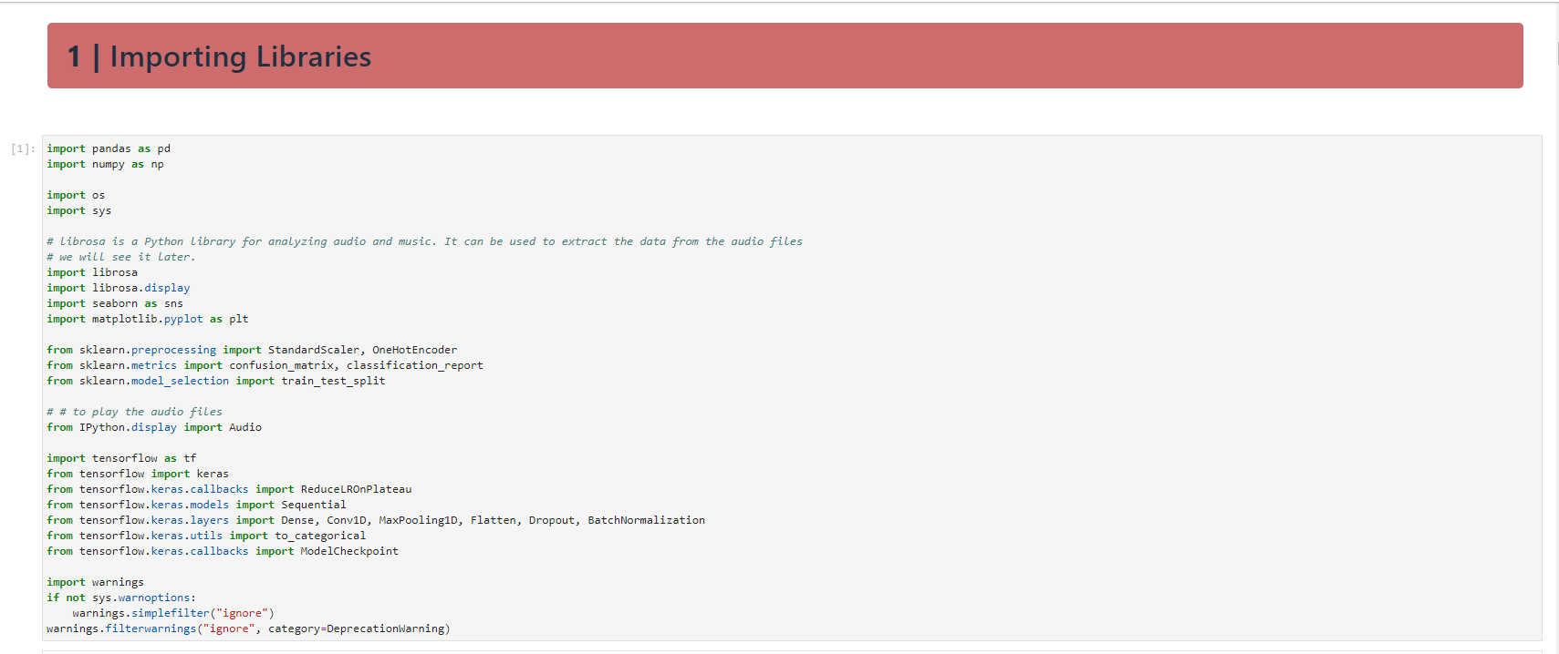

Slide 8
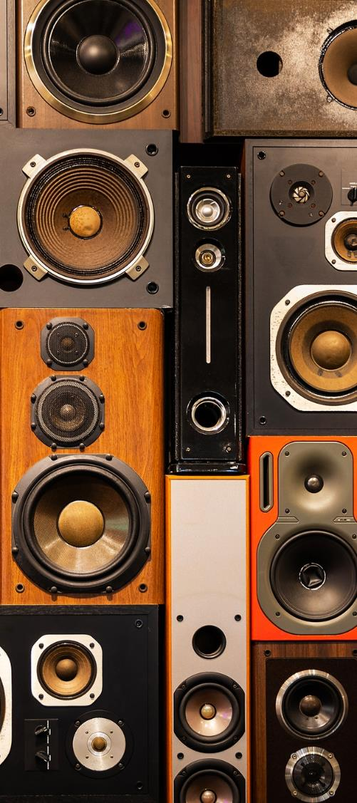
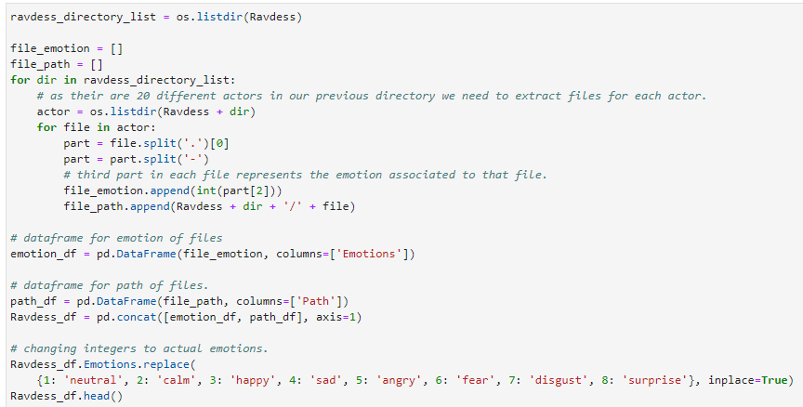
Data Preparation
Here are the filename identifiers as per the official
RAVDESS website as planned to be used in the project:
• Modality (01 = full-AV, 02 = video-only, 03 = audio only).
• Vocal channel (01 = speech, 02 = song).
• Emotion (01 = neutral, 02 = calm, 03 = happy, 04 = sad,
05 = angry, 06 = fearful, 07 = disgust, 08 = surprised).
• Emotional intensity (01 = normal, 02 = strong). NOTE:
There is no strong intensity for the ’neutral’ emotion.
• Statement (01 = ”Kids are talking by the door”, 02 =
”Dogs are sitting by the door”).
• Repetition (01 = 1st repetition, 02 = 2nd repetition).
• Actor (01 to 24. Odd-numbered actors are male, even numbered
actors are female).
8

Slide 9
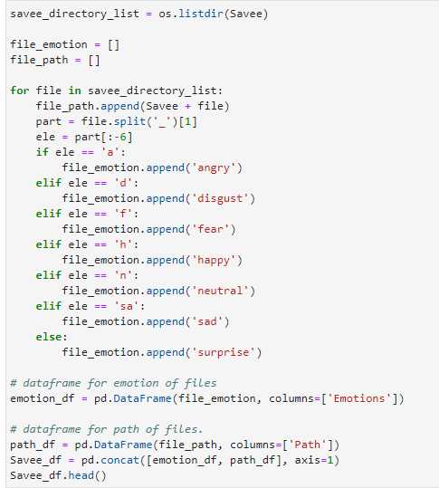
Data Preparation
There are 20 different actors in our previous directory we need to extract files for each actor.
• ’a’ = ’anger’
• ’d’ = ’disgust’
• ’f’ = ’fear’
• ’h’ = ’happiness’
• ’n’ = ’neutral’
• ’sa’ = ’sadness’
• ’su’ = ’surprise
9

Slide 10
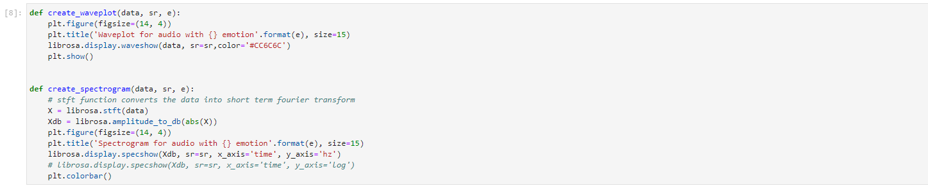
Data Visualization
We plan to use the below 2 techniques to visualize the data frames formed so far.
1) Waveplot - Waveplot let us know the loudness of the audio at a given time.
2) Spectrograms - A spectrogram is a visual representation of the spectrum of frequencies of sound or other signals as they vary with time. It’s a representation of frequencies changing with respect to time for given audio/music signals.

Slide 11
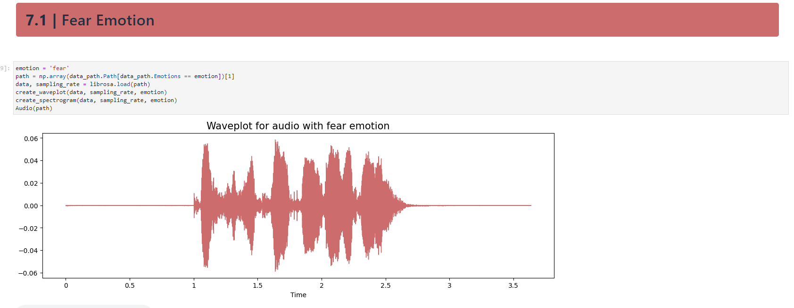
Data Visualization

Slide 12
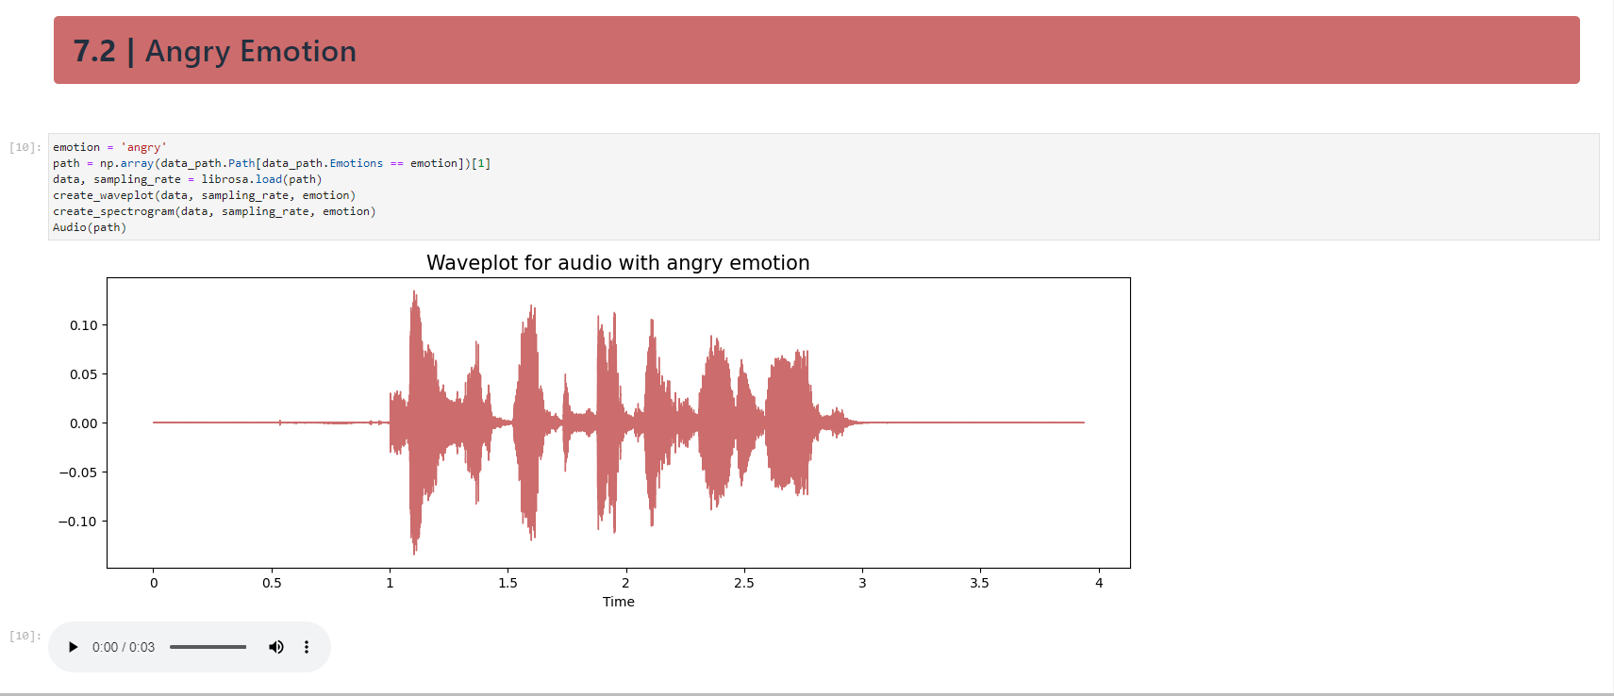
Data Visualization

Slide 13
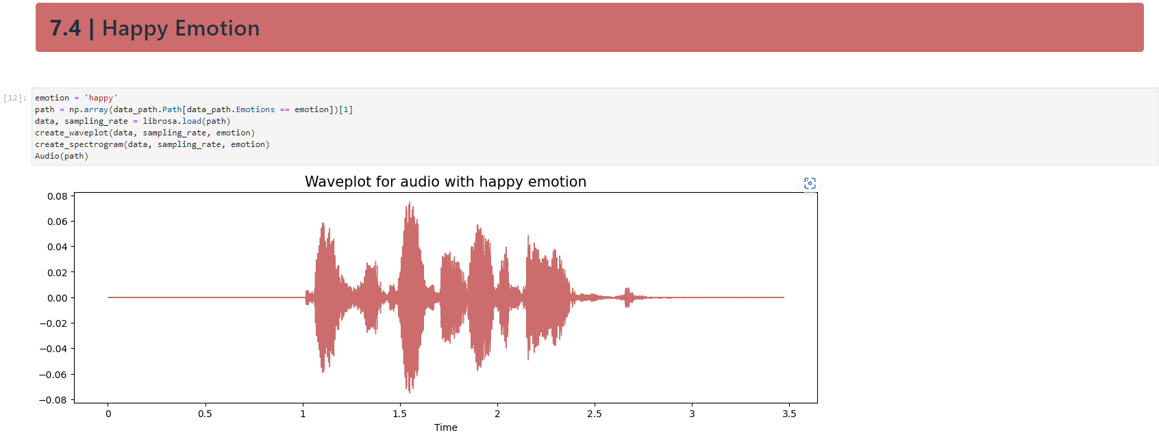
Data Visualization

Slide 14
Feature Extraction
Extraction of features is a very important part of analyzing and finding relations between different things. As we already know that the data provided by audio cannot be understood by the models directly, so we need to convert them into an understandable format for which feature extraction is used.
The audio signal is a three-dimensional signal in which three axes represent time, amplitude, and frequency.
As stated there with the help of the sample rate and the sample data, one can perform several transformations on it to extract valuable features.
In this project i am not going deep in feature selection
process to check which features are good for our dataset rather We are only extracting 5 features:
• Zero Crossing Rate
• Chroma stft
• MFCC
• RMS(root mean square) value
• MelSpectogram to train our model.
So far, the work has been done on data extraction and feature formation.
The upcoming reports will have the implementation
of Machine Learning models to this data.

Slide 15
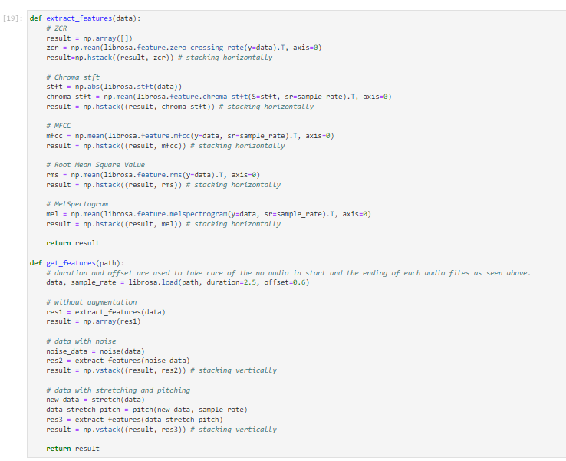
Feature Extraction

Slide 16
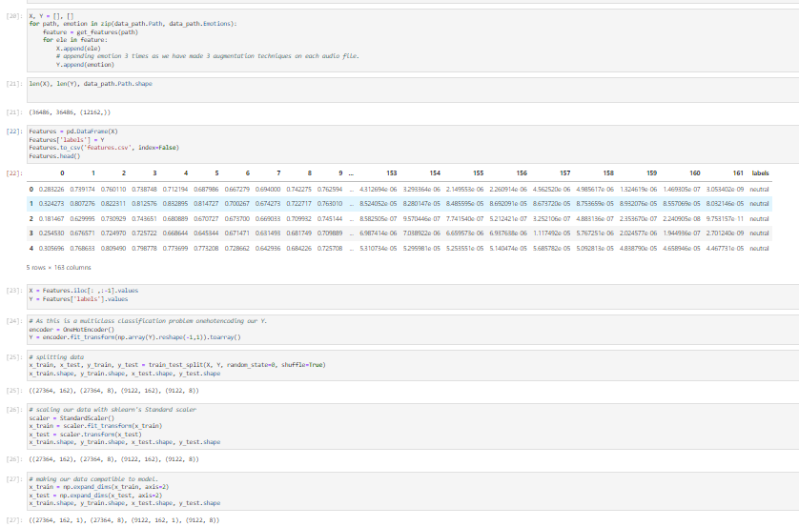
Feature Extraction

Slide 17
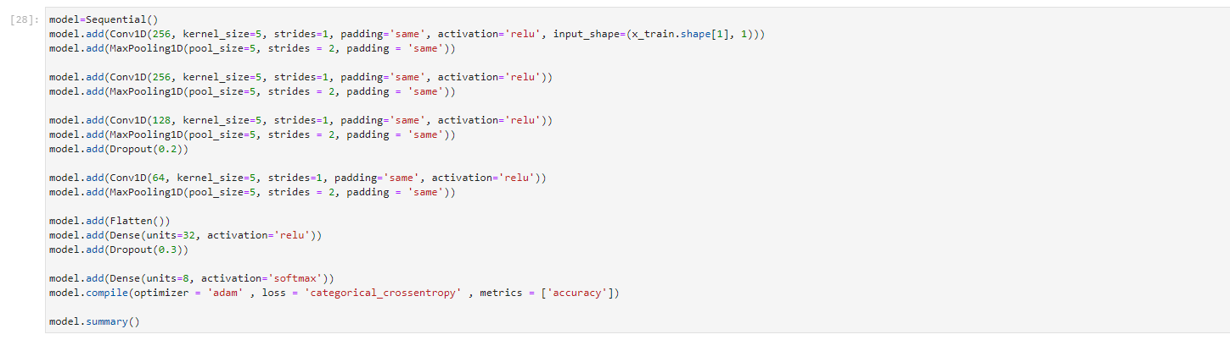
Adding model
A Sequential model is appropriate for a simple stack of layers with exactly one input and one output tensor. You can also incrementally build a Sequential model using the add() method. ‘relu’ is a non-linear activation function that is used in multi-layer neural networks

Slide 18
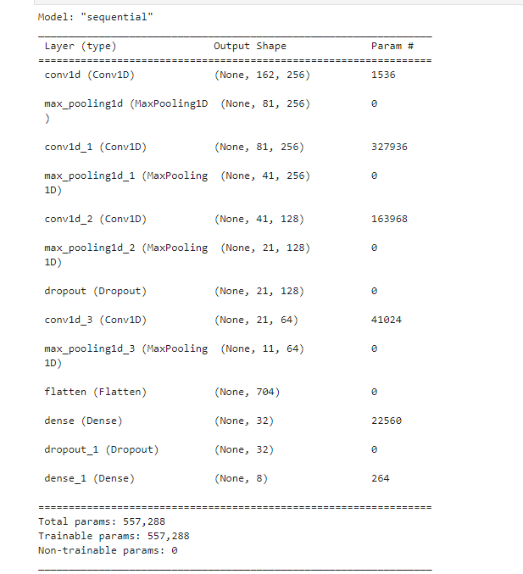
Adding model

Slide 19
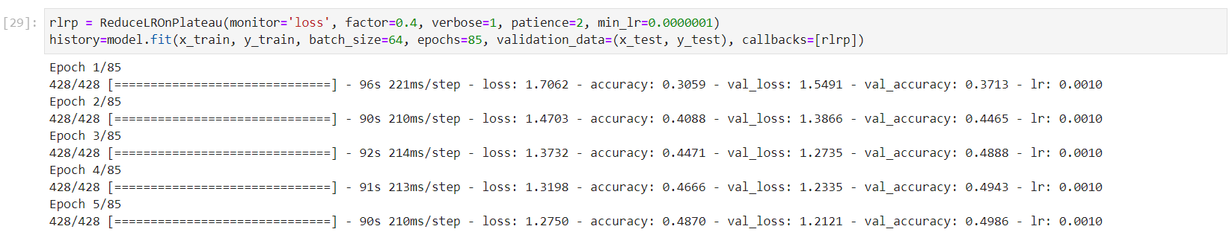
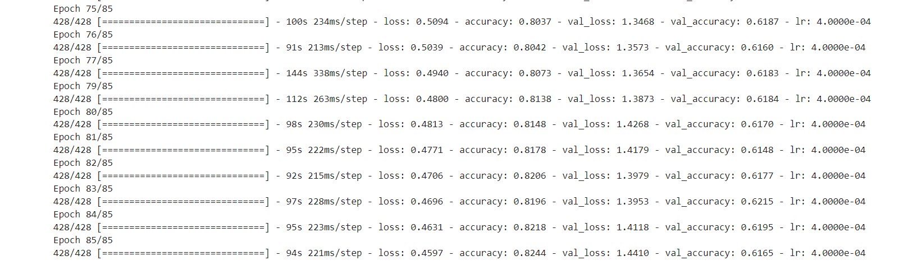
Adding model

Slide 20
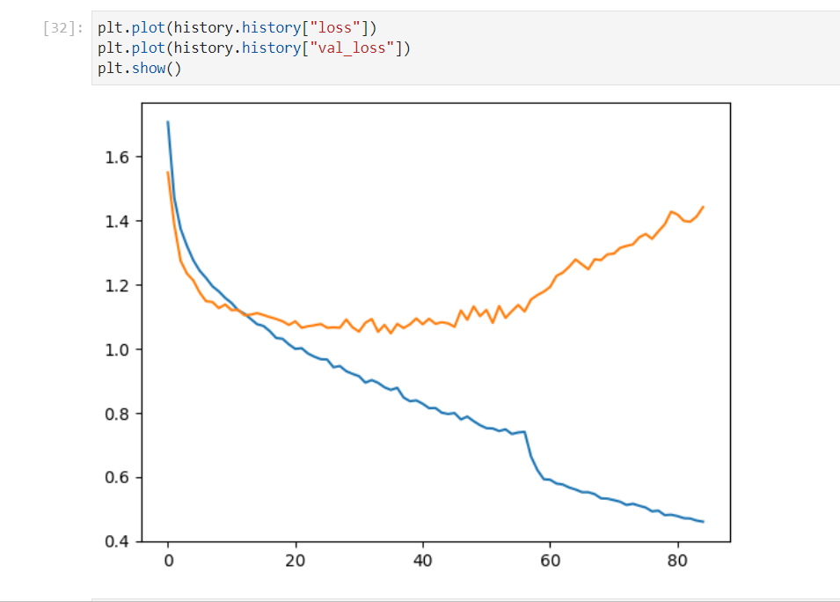
Adding model
The below plot shows the history loss:

Slide 21
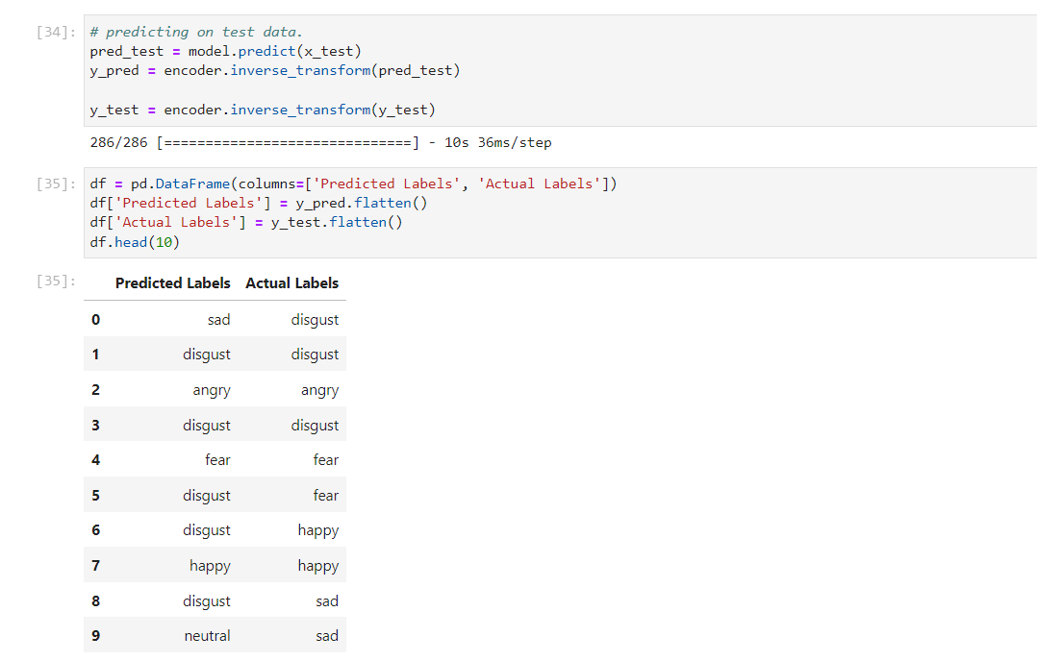
Adding model
Prediction on test data

Slide 22
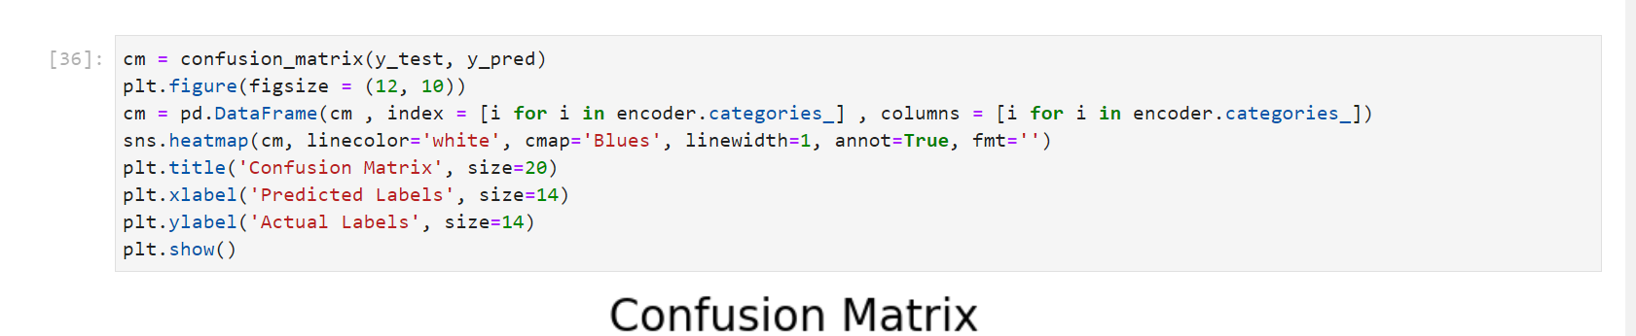
Confusion Metrix

Slide 23
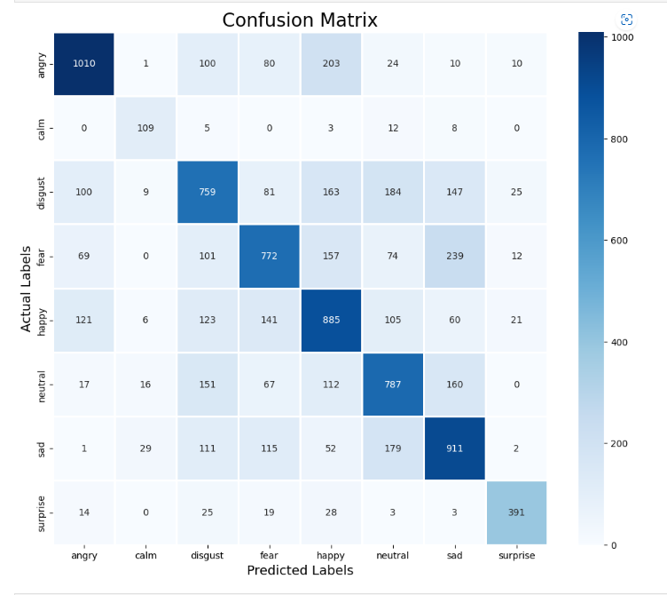
Confusion Metrix

Slide 24
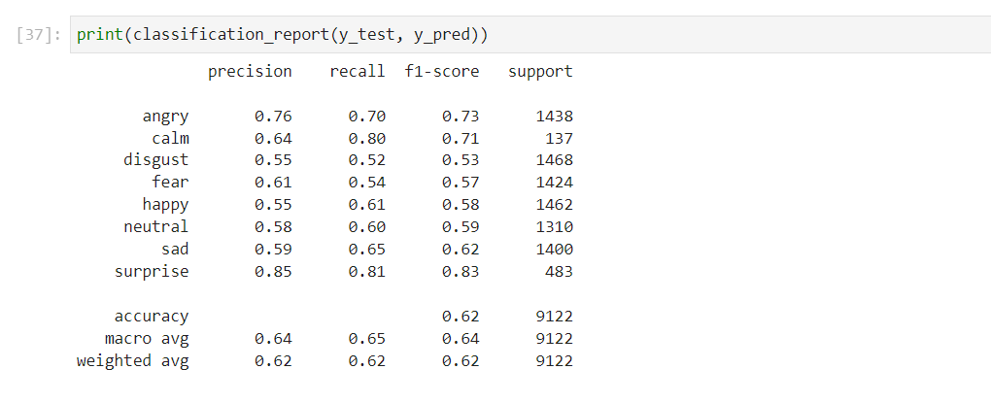
Confusion Metrix
Below is the classification of the data based on the important features.

Slide 25

Thank You

